Slide 1
一個以Harel Statechart為基礎的
圖型使用者介面測試案例產生工具
A Tool for GUI Test Case Generation
Based on Enhanced Harel Statechart
王振宇
台北科技大學 資訊工程所
2008/07/30

Slide 2
Outline
Introduction
Related work
Harel Statechart
  XOR decomposition, AND decomposition
  What AND can’t be done
  Enhancement: Composition and Inheritance
Harel Statechart Editor
Testing process
Demo
Experimental results
Conclusion

Slide 3
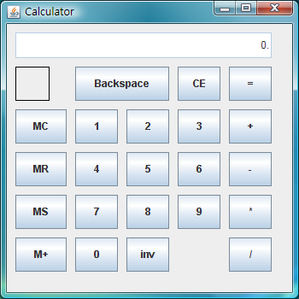
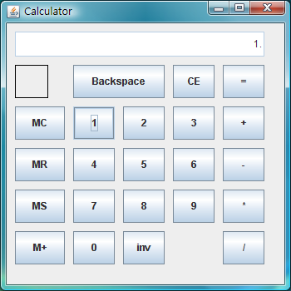
1. Introduction
GUI Testing
  User raises events on GUI by using keyboard or mouse
  Raise a sequence of events, and check if the state is as expected or not
Show “1”
Push “1”

Slide 4

1. Introduction
Methodology of GUI Testing
  Capture and Replay
  Programming ( JUnit + Jemmy )
  Edit test script (榮麒)
  Contract Language (勝凱)
  Finite State Machine Model (先達)

Slide 5
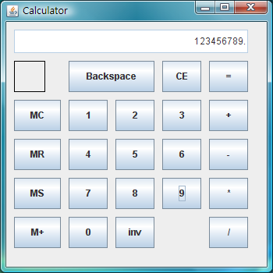
1. Introduction
Transition
Event
State
+,-,*,/
Initial
0..9
0..9
=
start
1..9
left -
operand
pushed
operator
pushed
1..9
right -
operand
pushed
=
computed
+,-,*,/
+,-,*,/
CE
A partial FSM for calculator

Slide 6
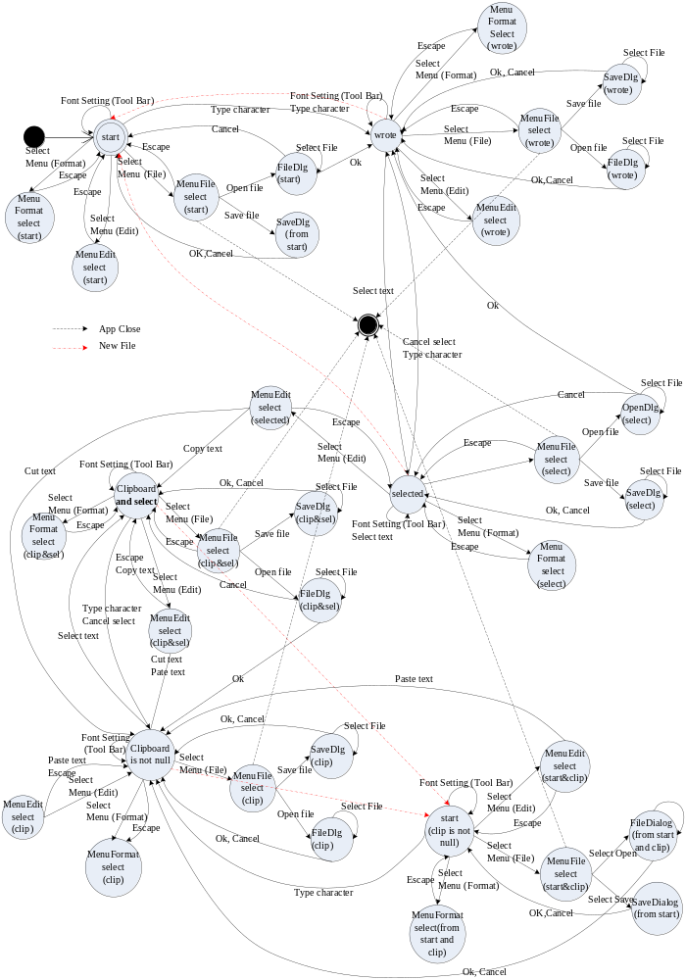
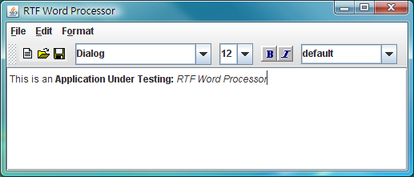
1. Introduction
Word Processor

Slide 7
1. Introduction
2
1
Characteristic of
FSM GUI Model
  Many States
  Many Transitions
  Many Similar Patterns are Repeated
    E.g. Clipboard (Copy and Paste)
    E.g. Selected/ Unselected
4
3
5
5
6
6

Slide 8
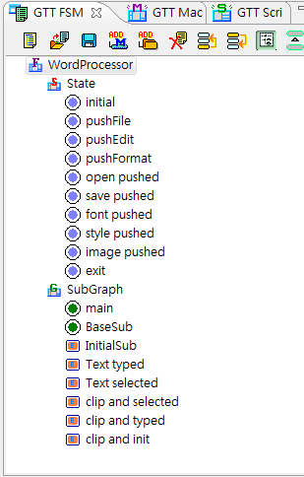
1. Introduction
HFSM (Hierarchical Finite State Machine) model
  Use a Tree View to build FSM
  model that support Composition
  and Inheritance to reuse states
  Support Test Case Generation
Problem
  Existing Visual Editors do not
  support Composition and Inheritance
  No Orthogonality support
  No GUI Test Case Generation support

Slide 9

1. Introduction
Solution proposed in this thesis: Visual FSM Editor based on David Harel Statecharts
  Provide a Visual FSM Editor that support Composition (multiple instances) and Inheritance
  Support Orthogonality
  Support GUI Test Case Generation

Slide 10

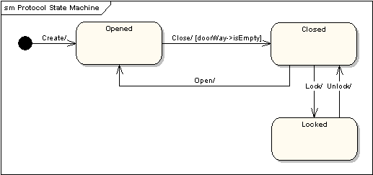
2. Related work
Enterprise Architect
  It is a Computer Aided Software Engineering (CASE) tool for designing and constructing software systems.
  Support for all 13 UML 2.1 diagrams
  Support Superstate
    But, no Composition and no Inheritance of Superstate
    Not support Orthogonality
    Can’t Generation Test Case

Slide 11

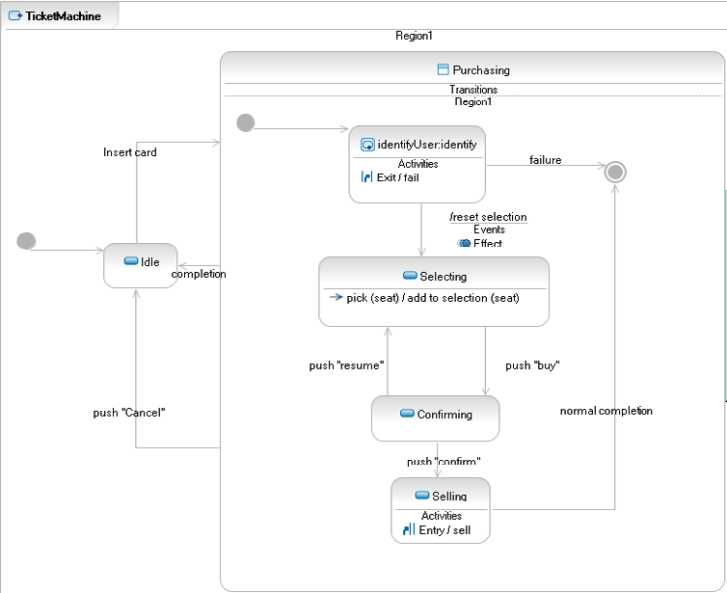
2. Related work
IBM Rational
Software Architect
  Built on Eclipse 3.2, Supports UML 2.1
  Support Superstate
    But, no Composition and
    no Inheritance of Superstate
    Not support Orthogonality
    Can’t Generation Test Case

Slide 12

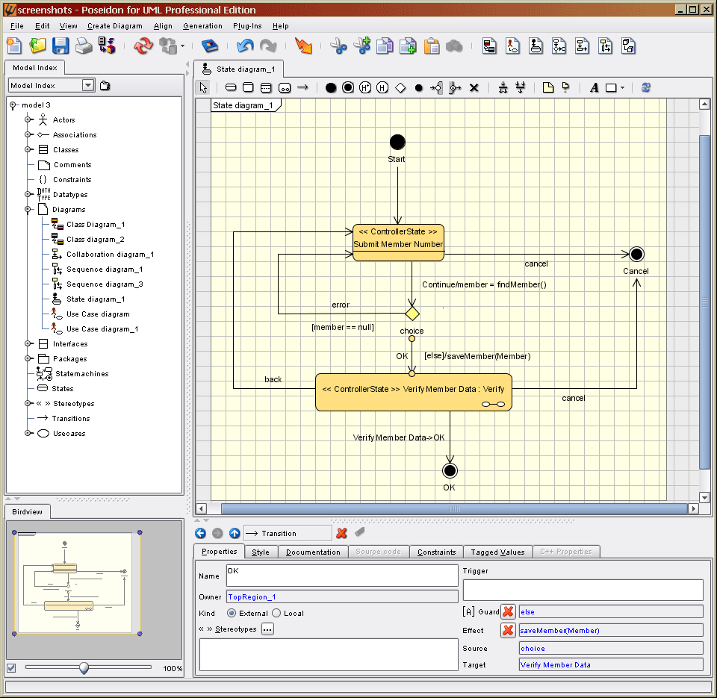
2. Related work
Poseidon for UML 6.0
  Supports all 9 diagrams of the UML
  Code generation for Java
  Support Orthogonality
    But, no Composition and
    no Inheritance
    Can’t Generation Test Case
Notes:
功能強大但無完整的 Statecharts 特性
因此我們希望針對不足之處加以提升..

Slide 13
2. Related work
Tool | Description | UML support | C&I support | AND support | TCG
EA | Enterprise Architect是一套Computer Aided Software Engineering(簡稱CASE工具)，用來建構和設計軟體系統的架構圖 | 13 | No | No | No
RSA | IBM Rational Software Architect是一套符合UML標準的綜合開發塑模開發環境 | 13 | No | No | No
PUML | Poseidon for UML是一套專業UML模型設計工具，提供免費社區版。由Open source的ArgoUML而來 | 9 | No | Yes | No
C&I: Composition and Inheritance / TCG: Test Case Generation
Notes:
功能強大但無完整的 Statecharts 特性
因此我們希望針對不足之處加以提升..

Slide 14
3. Statechart
David Harel
  Known for his work on dynamic logic and software engineering. In 1980s he invented Statecharts
  Statechart has been adopted as part of UML Standard
XOR decomposition
  State-levels: Clustering and Refinement
AND decomposition
  Orthogonality: Independence and Concurrent

Slide 15
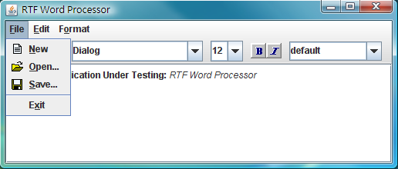
3.1 XOR decomposition
File Handle
Open
OpenDialog
MenuFile
SaveDialog
Save
Word Processor
Superstate
OpenFile
Allowed
File Handle
Open
OpenDialog
File
Typing
MenuFile
ESC
Save
SaveDialog
SaveFile
A partial FSM for calculator

Slide 16
3.1 XOR decomposition
File Handle
Open
OpenDialog
MenuFile
SaveDialog
Save
Word Processor
Superstate
OpenFile
Open
OpenDialog
File
Typing
MenuFile
ESC
Save
SaveDialog
SaveFile
A partial FSM for calculator

Slide 17
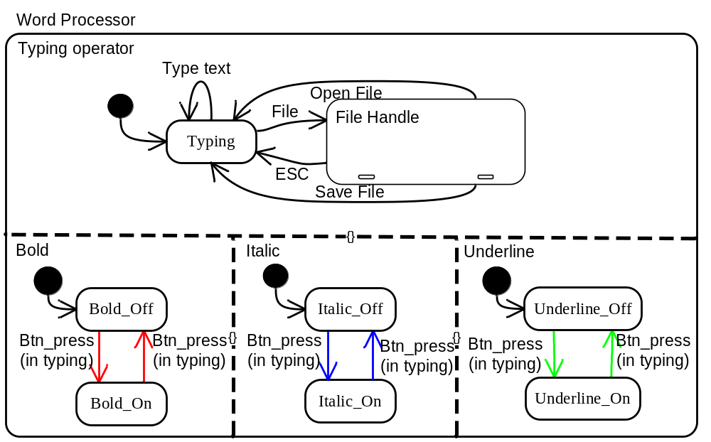
3.1 AND decomposition
Word Processor is the orthogonal product of Typing operator, Bold, Italic and Underline
Statechart’s Orthogonality for Word processor

Slide 18
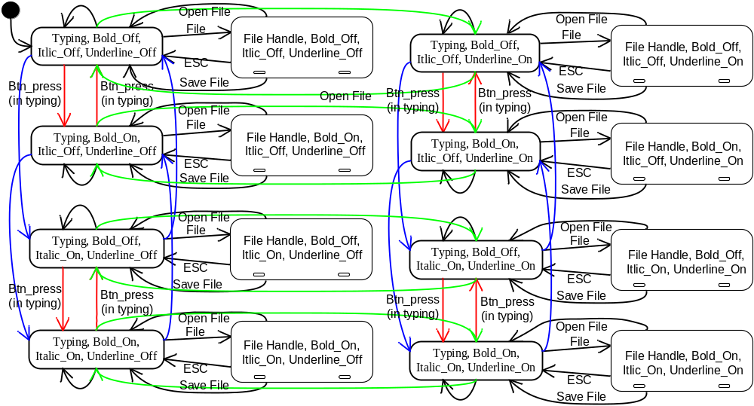
3.1 AND decomposition
Statechart’s Orthogonality for Word processor

Slide 19
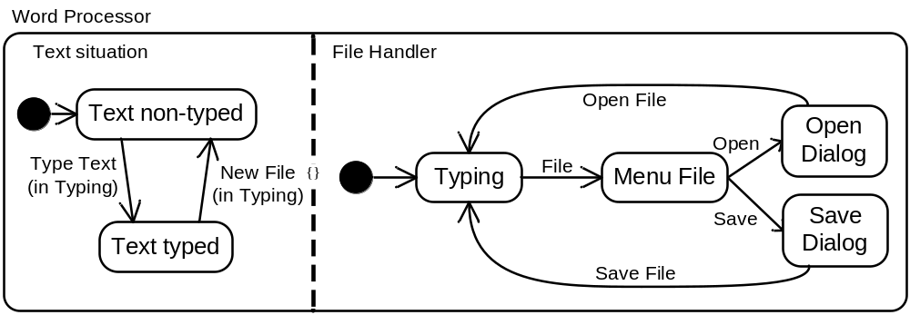
3.2 What AND can’t be done
AND decomposition is powerful, but…
We want to make same extension for this AND decomposition
Statechart’s Orthogonality for Word processor

Slide 20

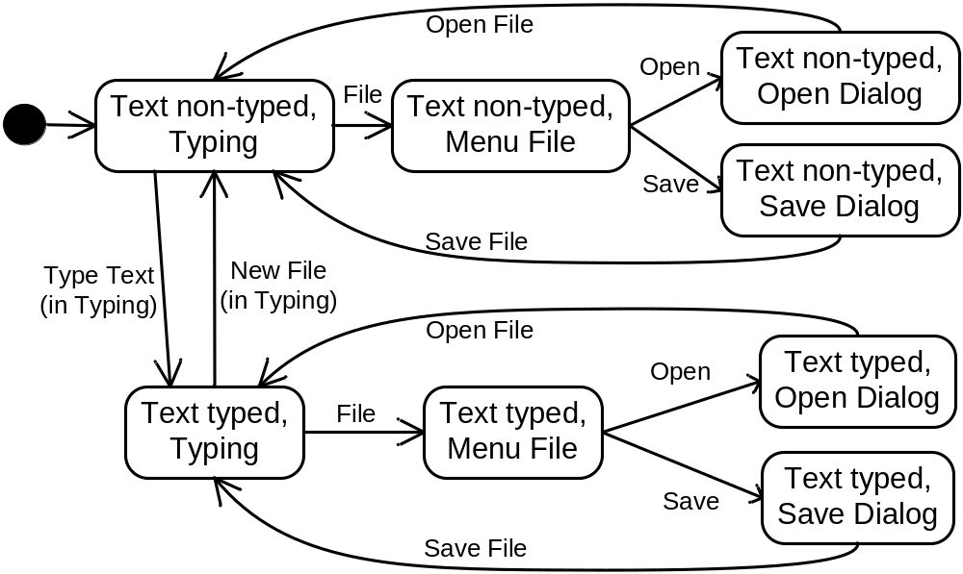
3.2 What AND can’t be done
Is that right?
Statechart’s Orthogonality for Word processor

Slide 21
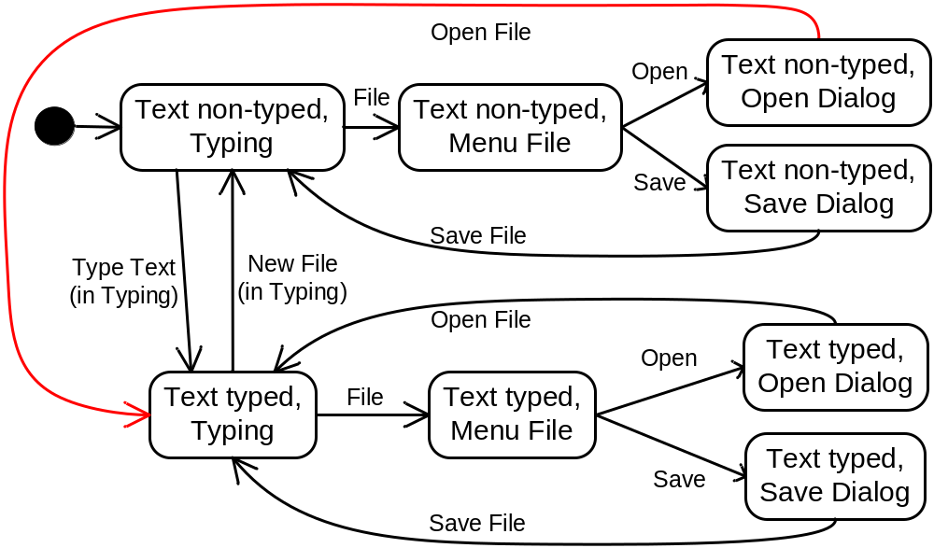
3.2 What AND can’t be done
That is Right!
Statechart’s Orthogonality for Word processor

Slide 22
3.3 Enhancement:
Composition and Inheritance
OpenFile
Open
OpenDialog
MenuFile
File
Save
SaveDialog
File Handle
OpenFile
SaveFile
Open
OpenDialog
start
File
MenuFile
File Handle
Save
SaveDialog
File Handle
Type text
New File
SaveFile
OpenFile
Open
OpenDialog
File
Text typed
MenuFile
File Handle
Save
SaveDialog
File Handle
SaveFile

Slide 23
3.3 Enhancement:
Composition and Inheritance
Open
OpenDialog
Base
Graph
X
File
MenuFile
Save
SaveDialog
SaveFile
File Handle
Open
OpenDialog
Initial File Handle
Text Typed File Handle
X
File
MenuFile
Initial File Handle
Save
SaveDialog
SaveFile
Derived
graph
Type text
New File
Open
OpenDialog
File
Text typed File Handle
X
MenuFile
Save
SaveDialog
SaveFile

Slide 24
4. Harel Statechart Editor
We propose an Harel Statechart Editor that support Visual Statechart Edition
  Support Composition and Inheritance to reuse model
  Support Orthogonality to reduce model
  Support Test Case Generation

Slide 25
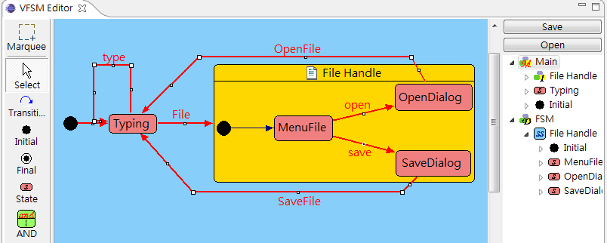
4. Harel Statechart Editor
How?
  We implement a Eclipse plug-in named Harel Statechart Editor that merged with GTT₄
  Using GEF to conquer Graphical problem
  My user interface like
Tool bar
Canvas
Tree View

Slide 26




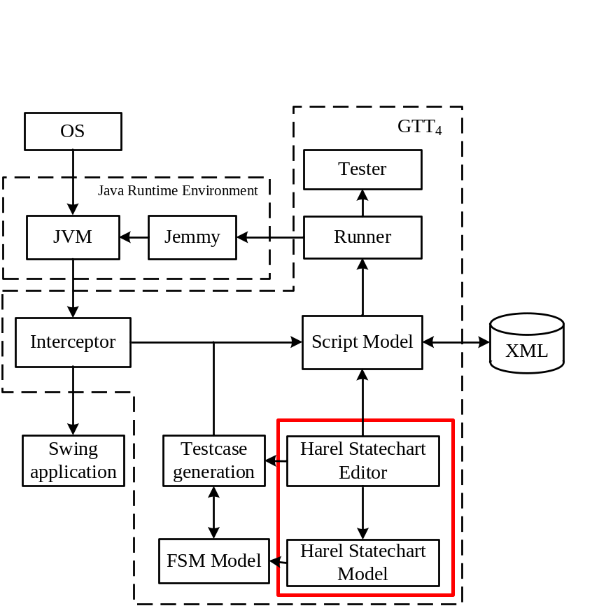




4. Harel Statechart Editor
OS
JVM
Jemmy
AP user
TCG
FSM
GTT₄ user
HSM

Slide 27
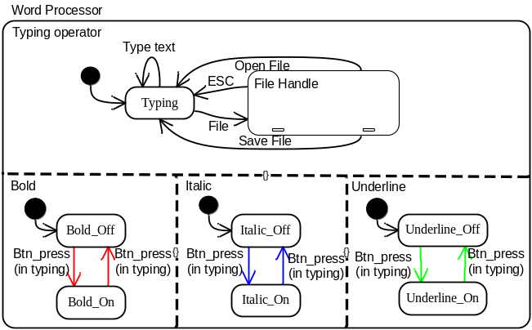



5. Testing process
Using Harel Statechart Editor
Harel Statechart Model
Run Test Case
Generate Test Case
Regular FSM Model

Slide 28
6. Demo

Slide 29
7. Experimental results
AUT
  Calculator
  Word Processor
Experiment
  Experiment 1
    Generation Test Case
  Experiment 2
    Usability Testing

Slide 30
7. Experimental results
Cost of C&I and AND decomposition (calculator FSM)
Amount of | Regular FSM | Composition | Composition & Inheritance | Orthogonality
Original states | 11
Original transitions | 152
State |  | 11 | 6 | 9
Superstate |  | N/A | 1 | N/A
Extended Superstate |  | N/A | 2 | N/A
Orthogonality |  | N/A | N/A | 1
Transition |  | 152 (100%) | 95 (62.5%) | 55 (36.1%)
Notes:
因為base graph的封裝, 使用繼承可以不用管封裝的內容,僅需針對增加的部份做新增,可以減少複雜度以及出錯的機率

Slide 31
8. Conclusion
We propose an Harel Statechart Editor that support Statechart
  Support Composition and Inheritance to reuse model
  Support Orthogonality to reduce model
  Support test case generation
Future work
  Generate test case for Condition and Actions
  Other Algorithms for Test case generation
Q & A

Slide 32
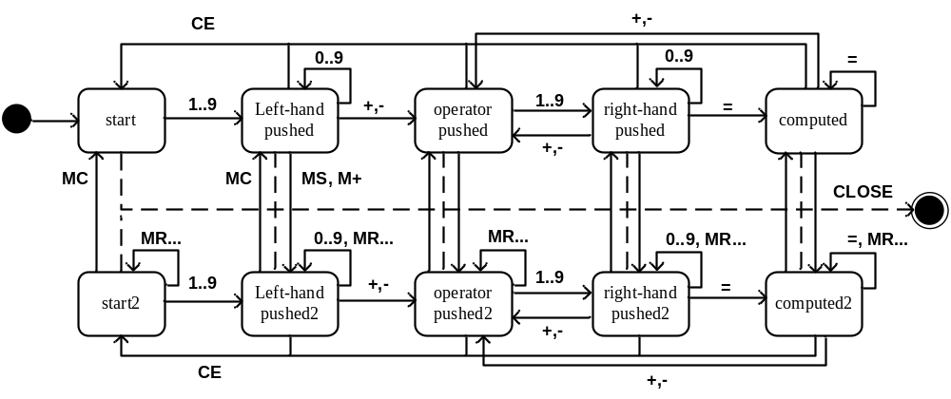
Regular FSM Model

Slide 33
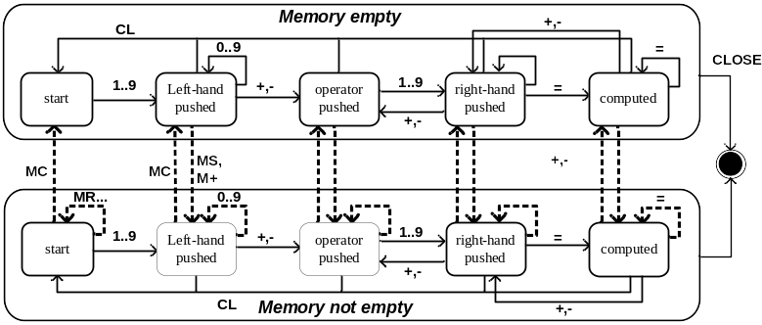
Composition and Inheritance

Slide 34
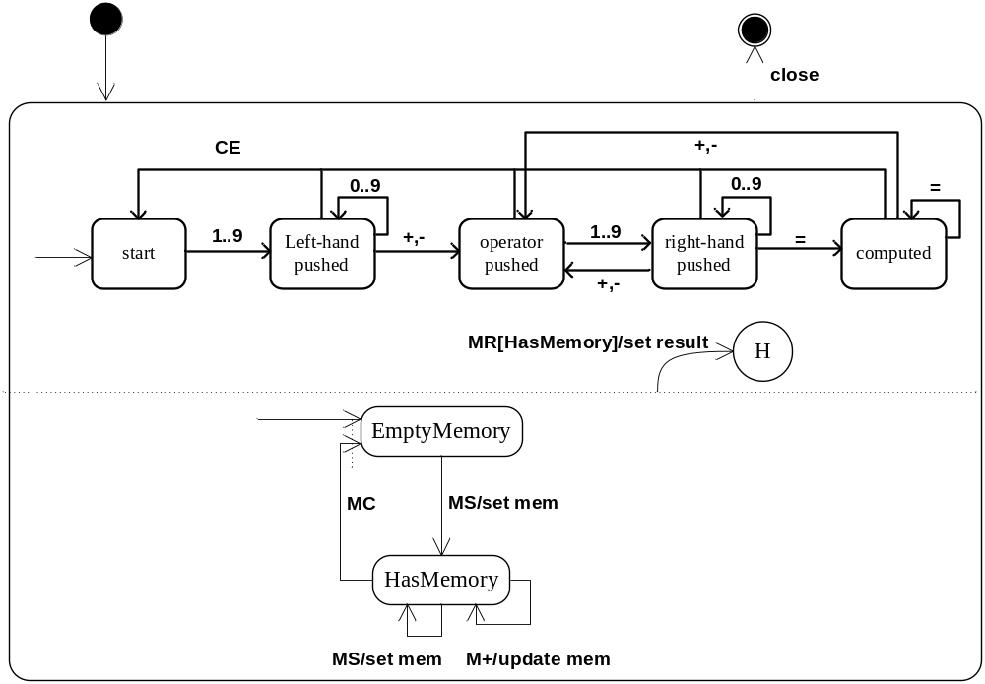
Orthogonality

